Slide 1


Prompting: Generalized Approach for Pre-trained Language Models
Advanced Deep Learning Architectures COMP5214 / ELEC 5680
Samuel Cahyawijaya
Centre for Artificial Intelligence Research (CAiRE)
The Hong Kong University of Science & Technology

Slide 2
Table of Content
Pre-training & Fine-tuning Regime
Scale of Language Models over Time
Generalization of Large Pre-trained Language Models
Prompt-based In-Context Learning
Prompt-based Training
Prompt-Tuning
Prompt-based Multi-task Pre-training
Conclusion

Slide 3
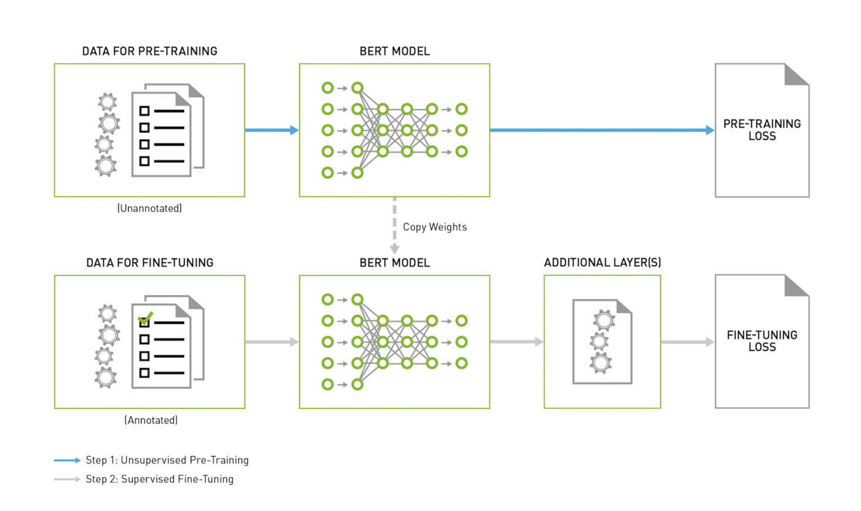
Pre-training & Fine-tuning Regime
Notes:
Table 1. The ethical principles endorsed by the Chinese National Governance Committee for the New Generation Artificial Intelligence and those elaborated by the European High-level Expert Group on AI (HLEGAI)

Slide 4
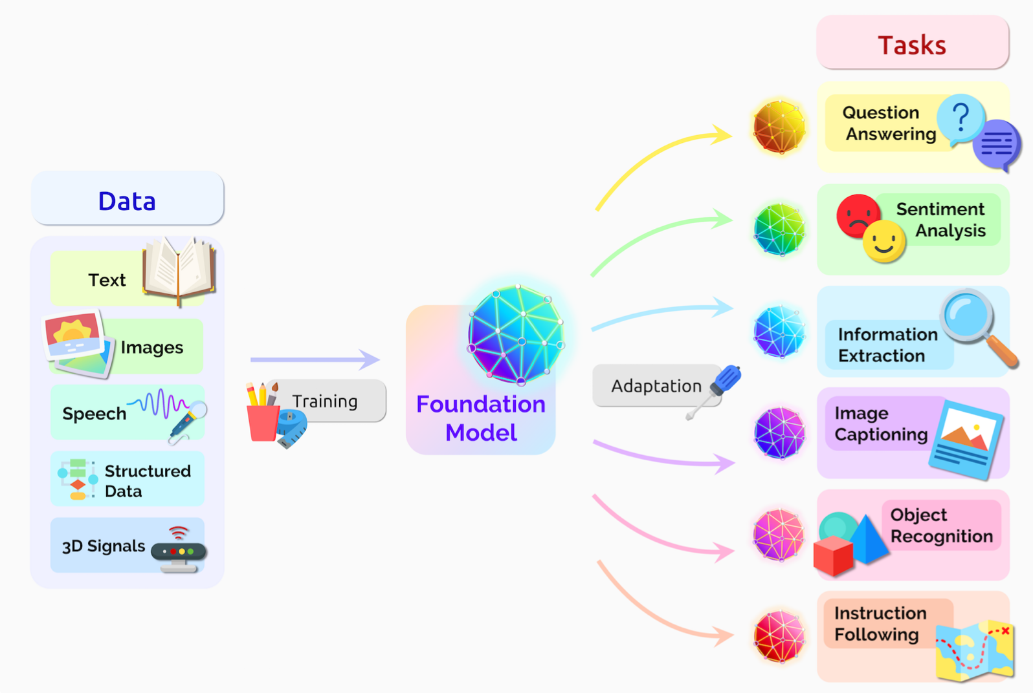
Foundation Models (Pre-trained Models)
“A foundation model centralizes the information from all the data from various modalities and this one model can then be adapted to a wide range of downstream tasks.” - Bommasani et al. 2021
From: On the Opportunities and Risks of Foundation Models (Bommasani et al. Aug 18, 2021)
Notes:
Fig. 2

Slide 5
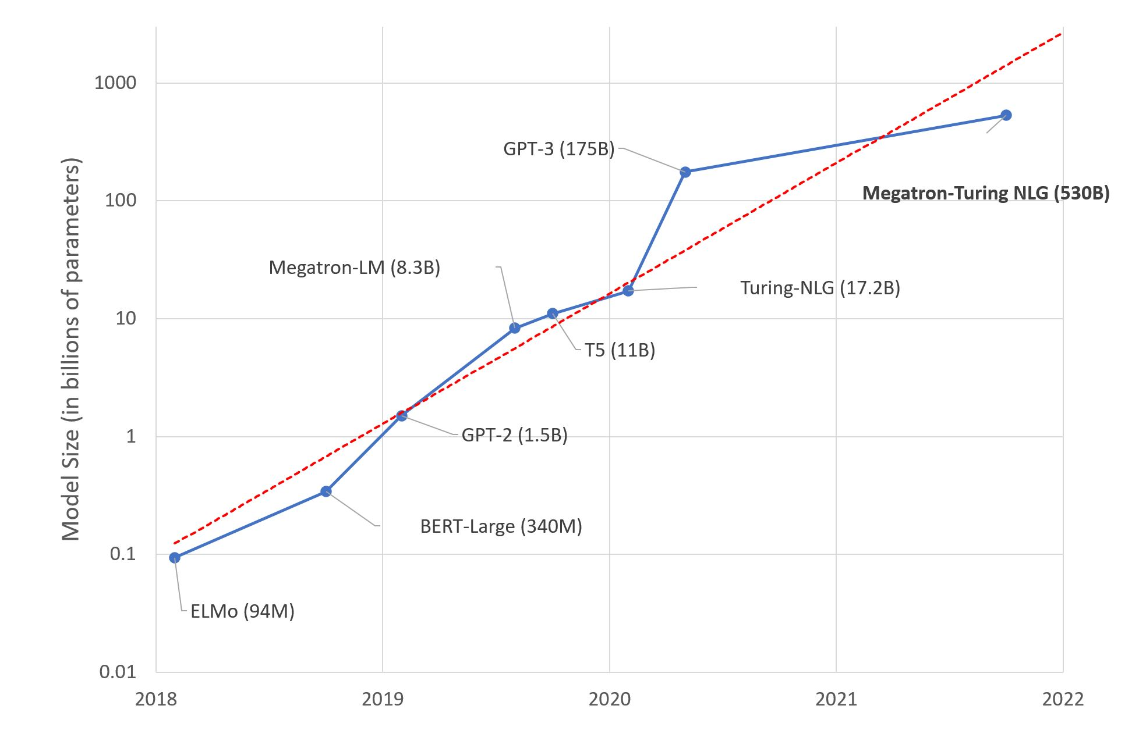
Scale of Language Models over Time
Even Larger LMs
M6-10T (10T)
Wu Dao 2.0 (1.75T)
Switch Transformer (1.6T)
Figure from https://research.aimultiple.com/gpt/

Slide 6
Generalization of Large Pre-trained Language Models

Slide 7
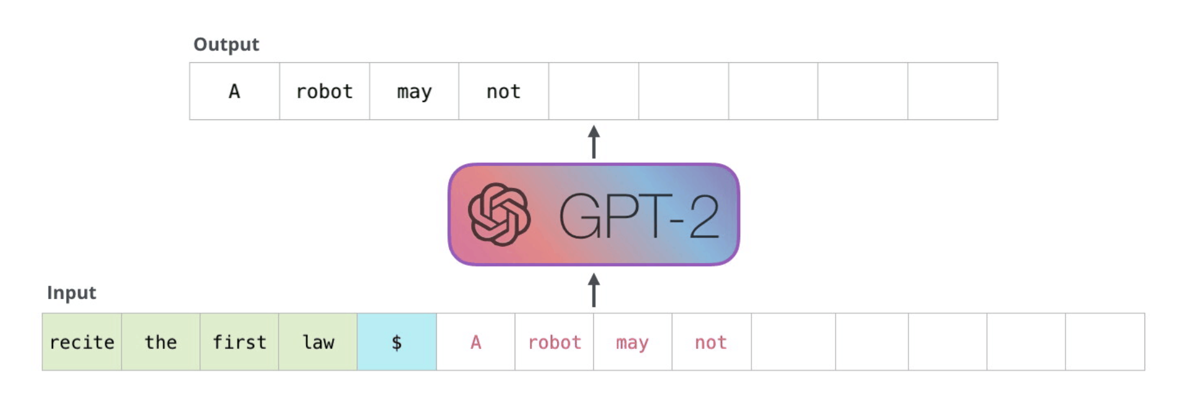
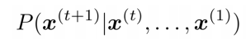
Prompt-based In-Context Learning
GPT is decoder-only model which does causal language modeling (CLM)
Notes:
Cost of large LM

Slide 8
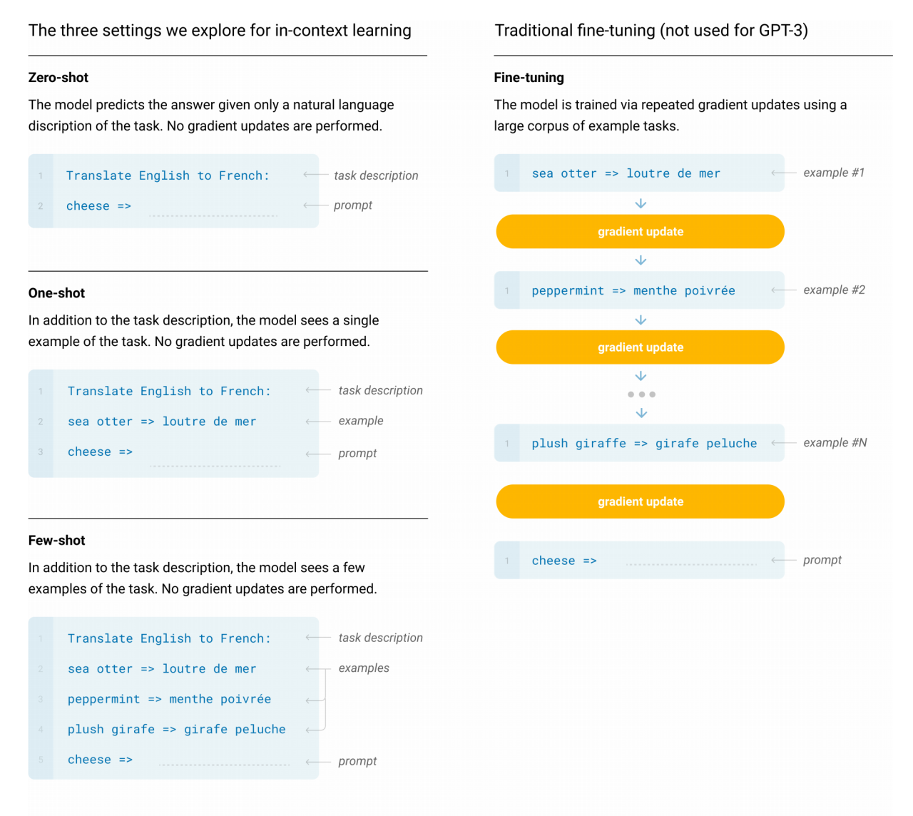
Prompt-based In-Context Learning
Notes:
Cost of large LM

Slide 9
Prompt-based In-Context Learning
GPT In-Context Learning Demo
https://6b.eleuther.ai/
Notes:
Cost of large LM

Slide 10
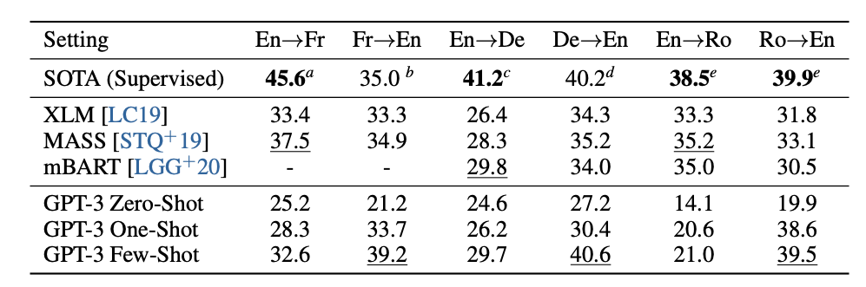
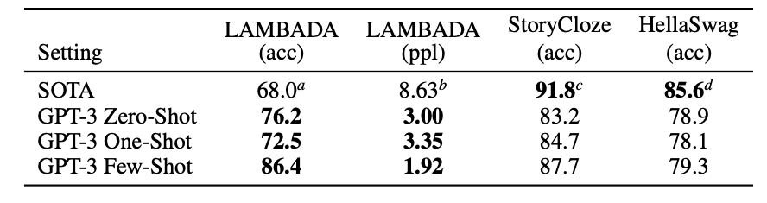
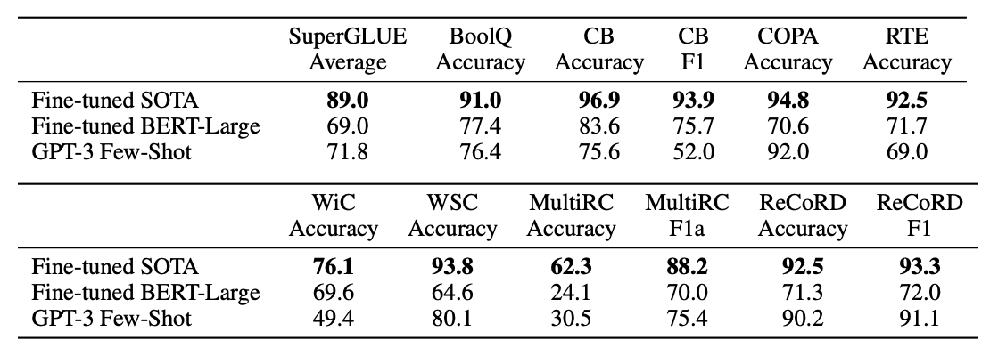
GPT3 on
Machine Translation
GPT3 on
Cloze Completion
GPT3 on
SuperGLUE
Notes:
Cost of large LM

Slide 11
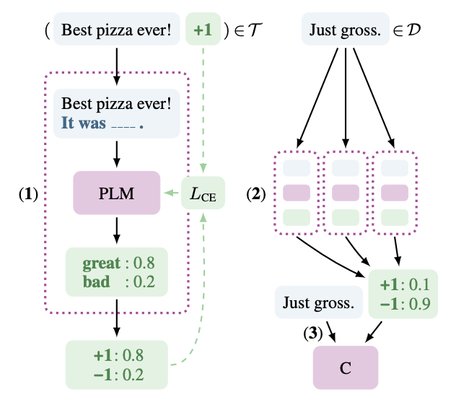
Prompt-based Learning | PET
Notes:
Cost of large LM

Slide 12
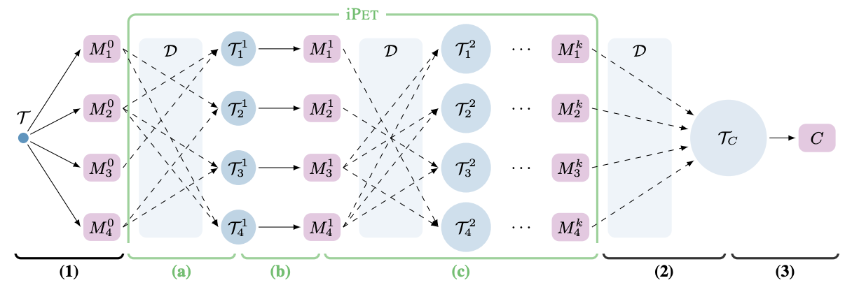
Prompt-based Learning | iPET
Notes:
Cost of large LM

Slide 13
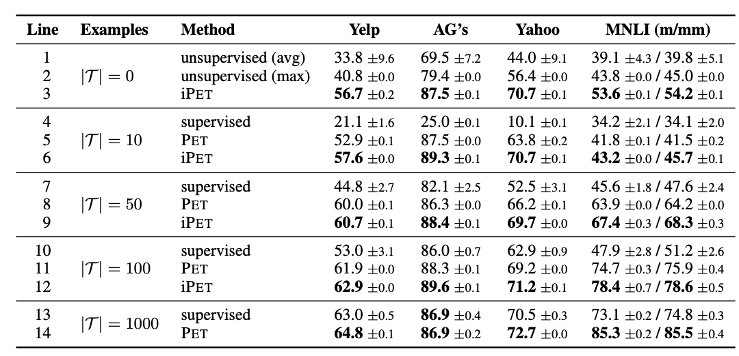
Prompt-based Learning | Result
(Schick and Schütze, 2021): Exploiting Cloze Questions for Few Shot Text Classification and Natural Language Inference
Notes:
Cost of large LM

Slide 14
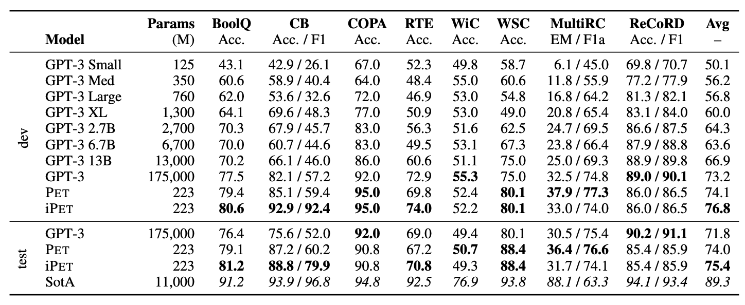
Prompt-based Learning | Result
(Schick and Schütze, 2021): It’s Not Just Size That Matters:Small Language Models Are Also Few-Shot Learners
Notes:
Cost of large LM

Slide 15
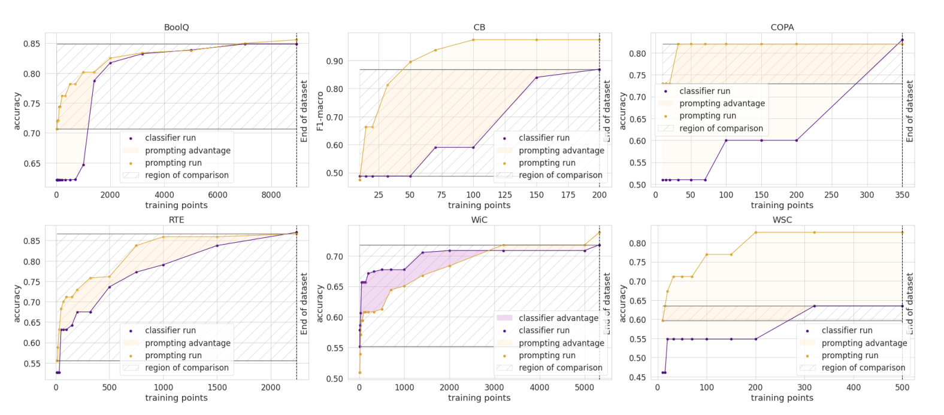
Prompt-based Learning | Result
(Scao and Rush, 2021): How Many Data Points is a Prompt Worth?
Notes:
Cost of large LM

Slide 16
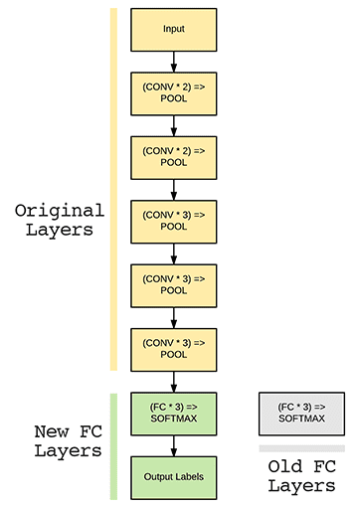
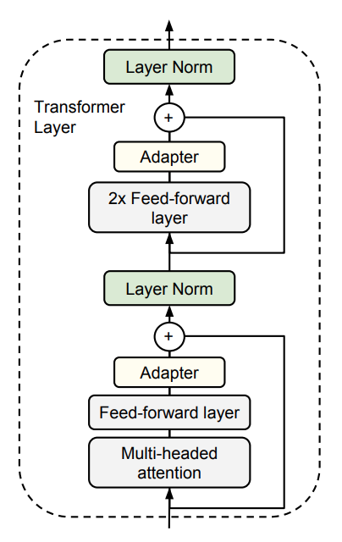
Prompt Tuning | Adapter
Classifier Head Tuning
Adapter Tuning
(Houlsby et al., 2019): Parameter-Efficient Transfer Learning for NLP
Notes:
Cost of large LM

Slide 17
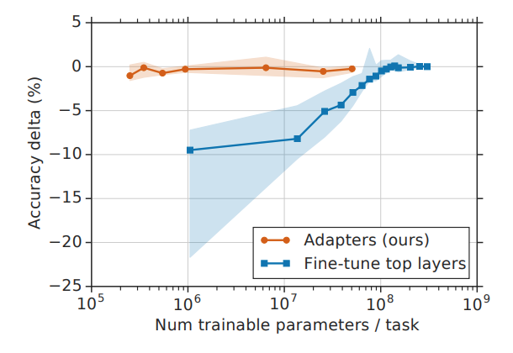
Prompt Tuning | Adapter
(Houlsby et al., 2019): Parameter-Efficient Transfer Learning for NLP
Notes:
Cost of large LM

Slide 18
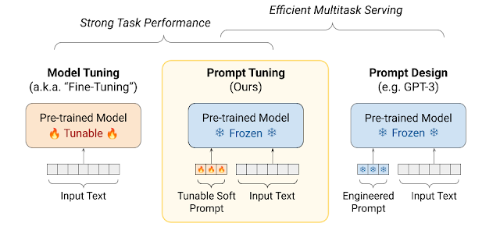
Prompt Tuning
(Lester et al., 2021): The Power of Scale for Parameter-Efficient Prompt Tuning
Notes:
Cost of large LM

Slide 19
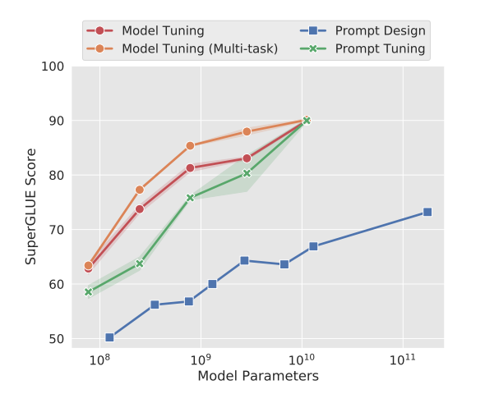
Prompt Tuning | Result
(Lester et al., 2021): The Power of Scale for Parameter-Efficient Prompt Tuning
Notes:
Cost of large LM

Slide 20
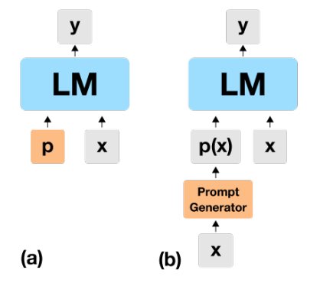
Input-Dependent Prompt Tuning (ID-PT)
Input-Dependent Prompt Tuning
Prompt Tuning
(Levine et al., 2022): Standing on the Shoulders of Giant Frozen Language Models
Notes:
Cost of large LM

Slide 21
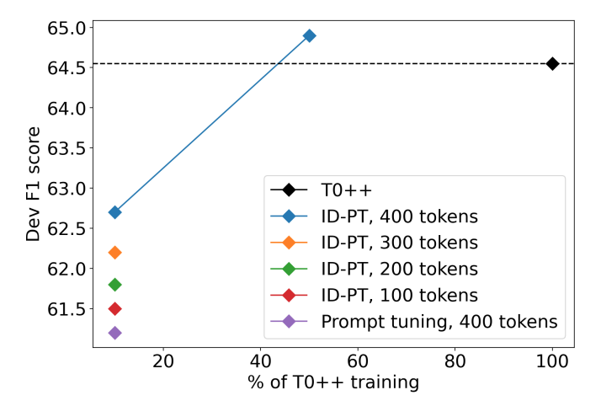
ID-PT | Result
(Levine et al., 2022): Standing on the Shoulders of Giant Frozen Language Models
Notes:
Cost of large LM

Slide 22
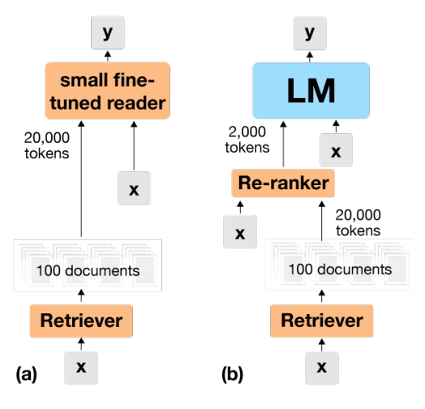
ID-PT | Retrieve-Read
Common Retrieve-Read
Frozen Retrieve-Read
(Levine et al., 2022): Standing on the Shoulders of Giant Frozen Language Models
Notes:
Cost of large LM

Slide 23
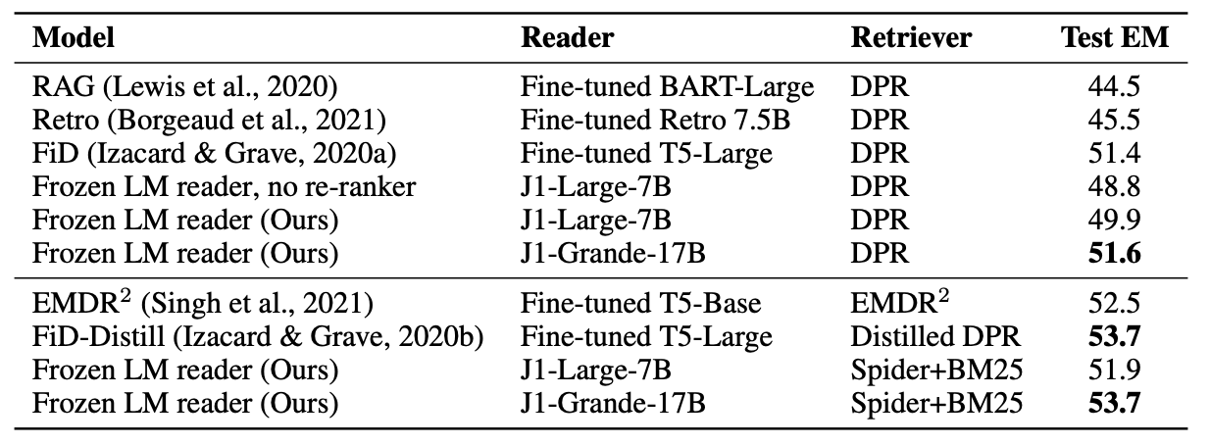
ID-PT | Retrieve-Read Result
(Levine et al., 2022): Standing on the Shoulders of Giant Frozen Language Models
Notes:
Cost of large LM

Slide 24
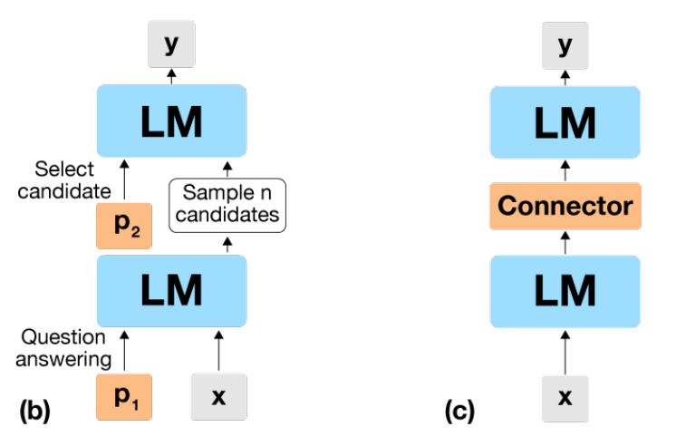
ID-PT | LM Recursion
Textual Recursion
Neural Recursion
(Levine et al., 2022): Standing on the Shoulders of Giant Frozen Language Models
Notes:
Cost of large LM

Slide 25
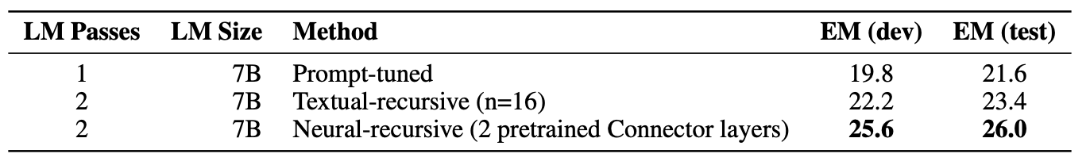
ID-PT | LM Recursion Result
(Levine et al., 2022): Standing on the Shoulders of Giant Frozen Language Models
Notes:
Cost of large LM

Slide 26
Prompt-based Multitask Pre-training
Convert downstream task into text-to-text prompting format
Perform 2nd-phase pre-training on a pre-trained LM
Perform Masked Language Modeling (MLM) on training & validation set of the downstream task
Evaluate the model on similar / completely different tasks
Notes:
Cost of large LM

Slide 27
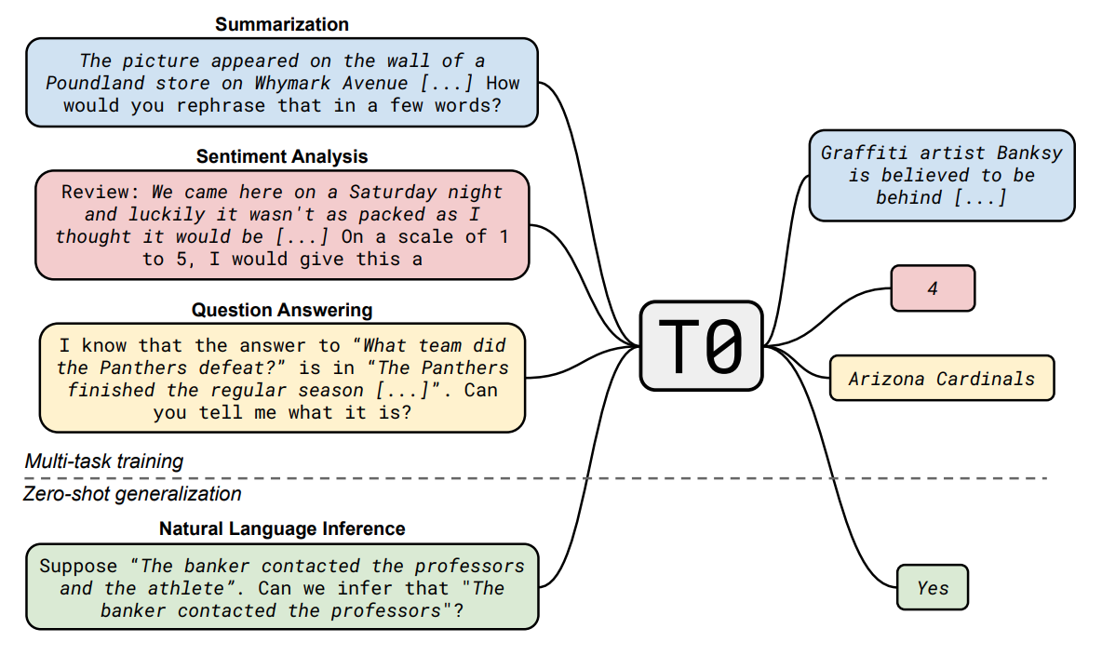
Prompt-based Multitask Pre-training | T0
(Sahn et al., 2022): Multitask Prompted Training Enables Zero-shot Task Generalization
Notes:
Cost of large LM

Slide 28
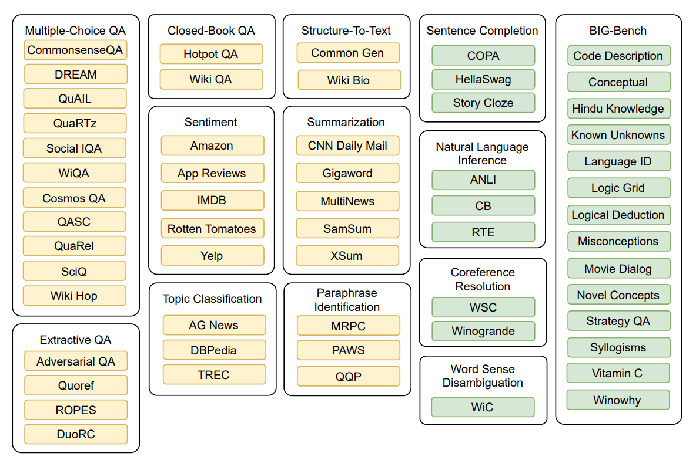
Prompt-based Multitask Pre-training | T0
(Sahn et al., 2022): Multitask Prompted Training Enables Zero-shot Task Generalization
Notes:
Cost of large LM

Slide 29
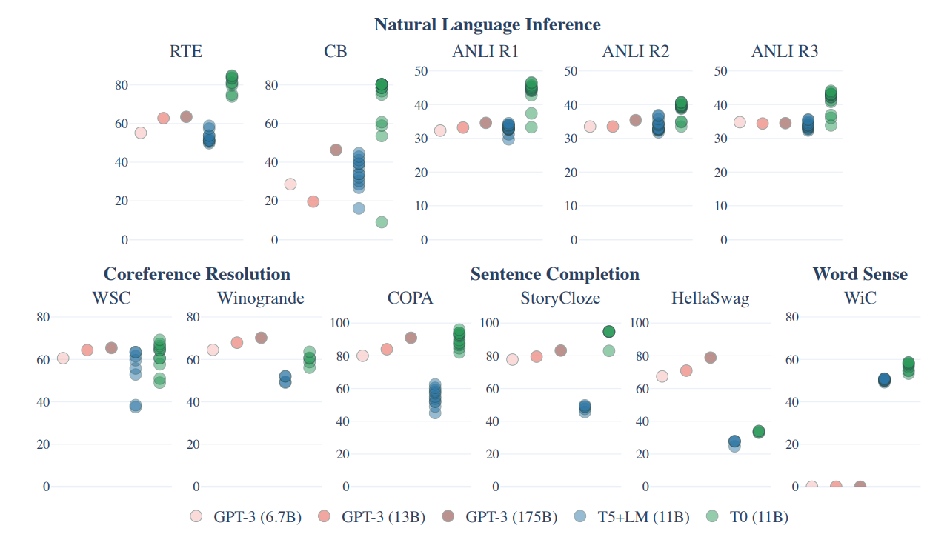
Prompt-based Multitask Pre-training | T0 Result
(Sahn et al., 2022): Multitask Prompted Training Enables Zero-shot Task Generalization
Notes:
Cost of large LM

Slide 30
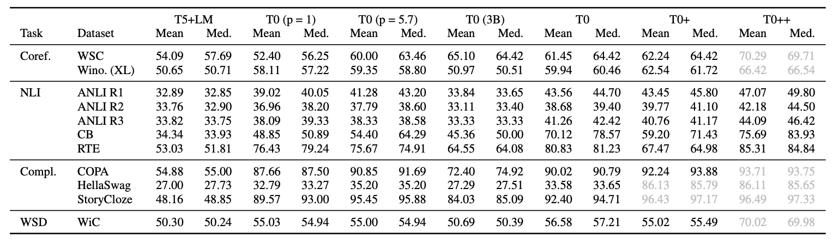
Prompt-based Multitask Pre-training | T0 Result
(Sahn et al., 2022): Multitask Prompted Training Enables Zero-shot Task Generalization
Notes:
Cost of large LM

Slide 31
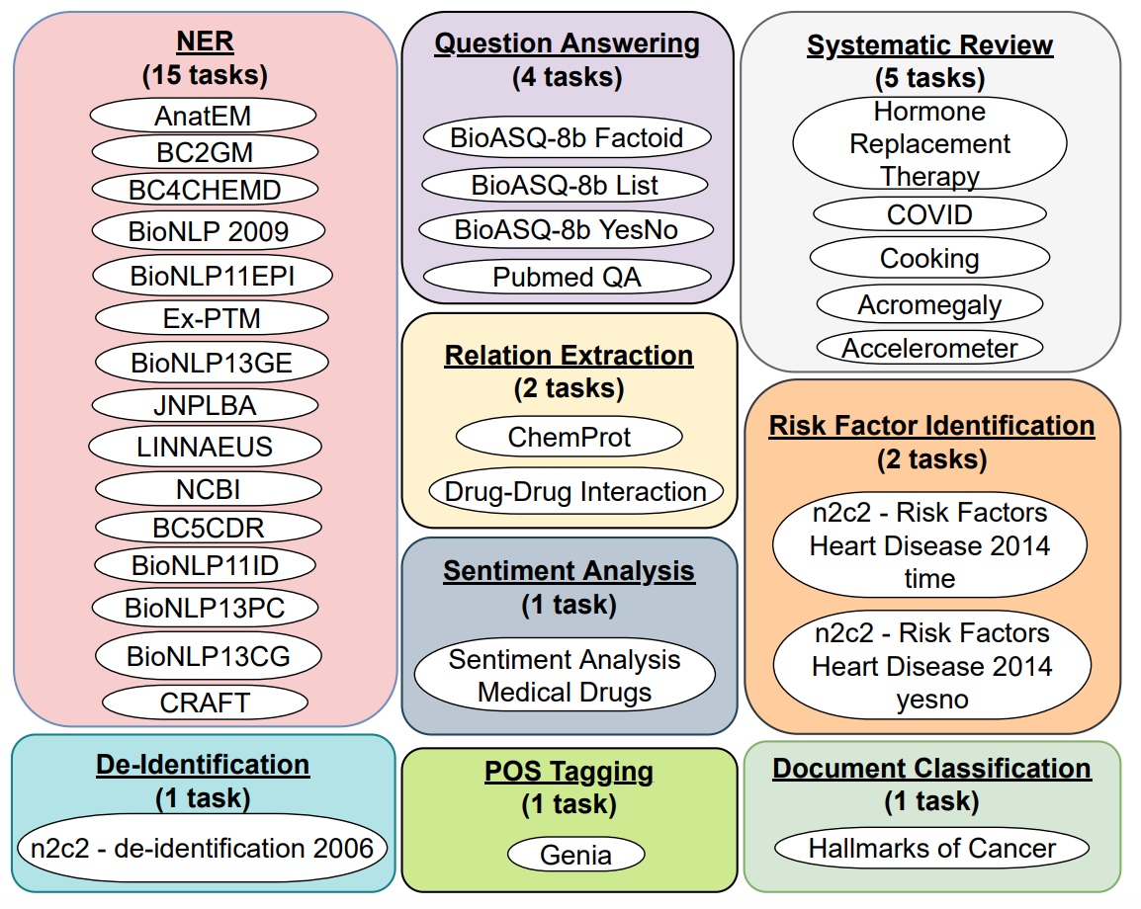
Prompt-based Multitask Pre-training | In-BoXBART
(Parmer et al., 2022): In-BoXBART: Get Instructions into Biomedical Multi-Task Learning
Notes:
Cost of large LM

Slide 32
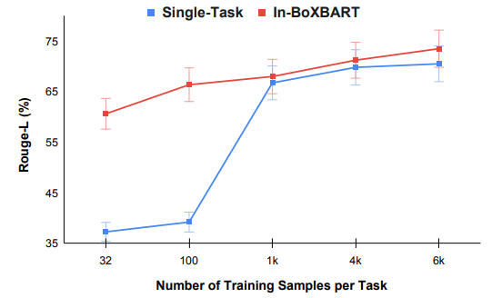
Prompt-based Multitask Pre-training | In-BoXBART
(Parmer et al., 2022): In-BoXBART: Get Instructions into Biomedical Multi-Task Learning
Notes:
Cost of large LM

Slide 33
Prompt-based Multitask Pre-training
T0++ Demo
https://huggingface.co/bigscience/T0pp
Notes:
Cost of large LM

Slide 34
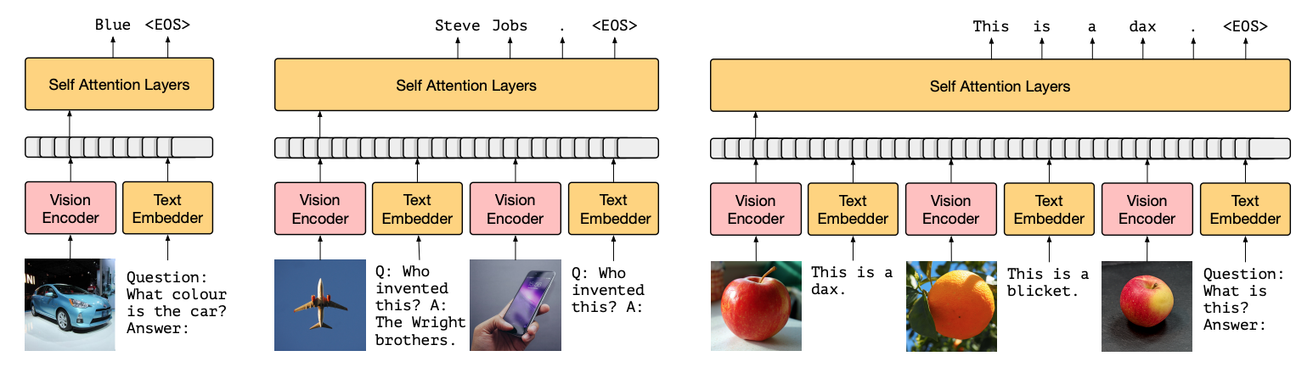
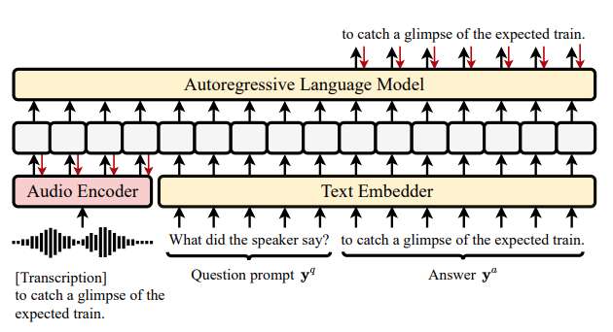
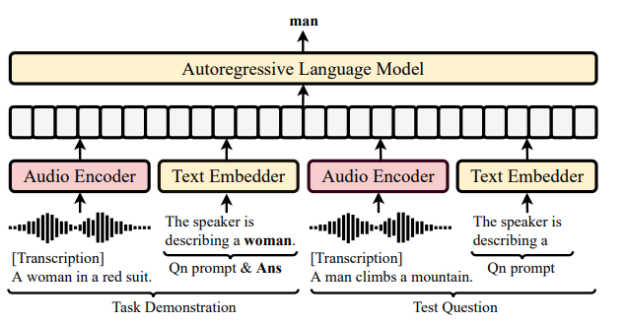
Adoption of Prompt-based Method
Frozen (Image-Text)
WAVPrompt (Audio-Text)
Notes:
Cost of large LM

Slide 35
Conclusion
Prompt-based method is one of the current trend in NLP because of its efficiency and generalizability especially on the low data regime
Prompt-based method has been applied for multiple use cases:
Zero-shot evaluation
Few-shot In-context Learning
Prompt-based Multitask Learning
Prompt-based method has also been adopted to other fields:
Computer Vision
Audio Processing
Prompt-based Training
Prompt-Tuning

